Slide 1
Lecture 3
Cloud Enabling Technologies
Cloud Deployment Models
Cloud Service Models
IaaS vs. PaaS vs. SaaS

Slide 2
Cloud Enabling Technologies
Broadband networks and internet architecture
Virtualization technology
SOA
Web Services , Web 2.0,3.0
Multitenant technology

Slide 3
Broadband networks & Internet architecture
All clouds must be connected to a network
This inevitable requirement forms an inherent dependency on internetworking.
Internetworks, or the Internet, allow for the remote provisioning of IT resources and are directly supportive of ubiquitous network access.

Slide 4
Internet Service Providers (ISPs)
Established and deployed by ISPs, the Internet's largest backbone networks are strategically interconnected by core routers that connect the world's multinational networks.

Slide 5
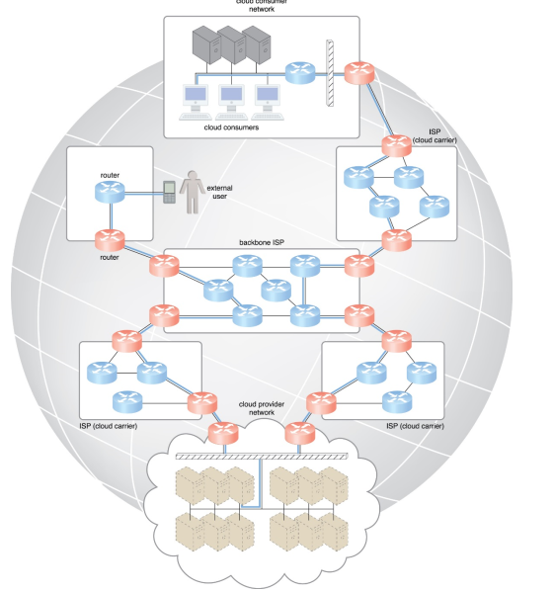

Slide 6
Cont.
Worldwide connectivity is enabled through a hierarchical topology composed of Tiers 1, 2, and 3
The core Tier 1 is made of large-scale, international cloud providers that oversee massive interconnected global networks, which are connected to Tier 2's large regional providers
The interconnected ISPs of Tier 2 connect with Tier 1 providers, as well as the local ISPs of Tier 3.

Slide 7
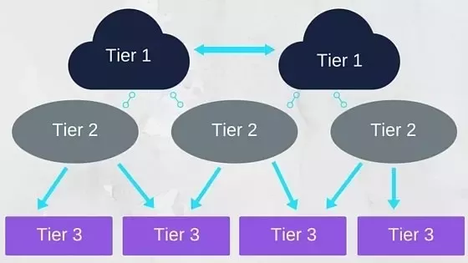
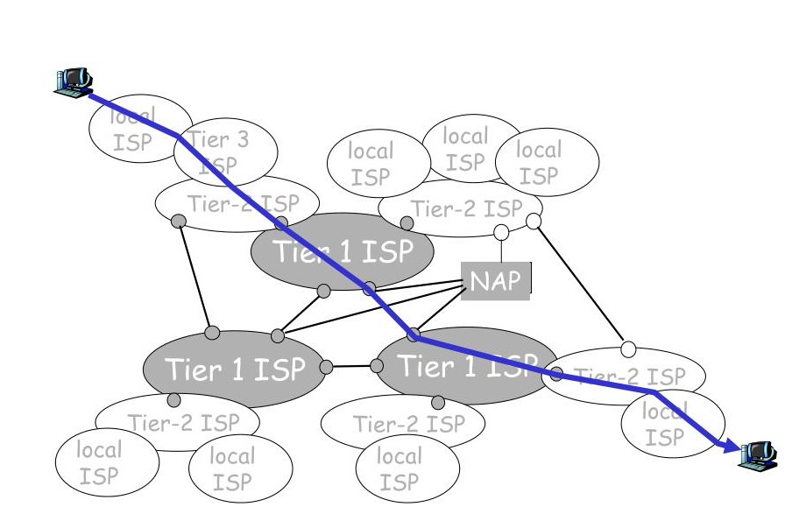

Slide 8
Virtualization
Virtualization is a process of converting a physical IT resource into a virtual IT resource
Server
Virtual server ↔ virtual machine
Storage
Network

Slide 9
SOA?

Slide 10
Case Study
Online Parking Ticket
Maps, Payments, User login & Authentication
Maps - Google Maps
Payments -Existing payment gateway
User Authentication – Facebook Gmail
The building-block services might employ pre-existing components that are reused, and can also be updated or replaced without affecting the functionality or integrity of other independent services

Slide 11
Service
Software component that provides a set of coherent and related functionalities that can be reused and integrated into bigger and more complex applications
Services are most often built in a way that is independent of the context in which they are used
A service is supposed to be
Loosely coupled- allows services to serve different scenarios more easily
Reusable
Programming language independent-increases services accessibility
location transparent

Slide 12
SOA: Service Oriented Architecture
Service-orientation is a way of thinking in terms of services and service-based development and the outcomes of services
Service orientation approach adopts the concept of services as the main building blocks of application and system development
It defines a way to make software components reusable via service interfaces

Slide 13
SOA: Service Oriented Architecture
SOA is a logical way of designing a software system to provide services to either end-user applications or to other services distributed in a network, via published and discoverable interfaces.
This architectural approach is particularly applicable when multiple applications running on varied technologies and platforms need to communicate with each other

Slide 14
Web services
Web services are the prominent technology for implementing SOA systems and applications
A Web service is a self-describing, self-contained software module available via a network, such as the Internet, which completes tasks, solves problems, or conducts transactions on behalf of a user or application.
Self-describing: It knows what functions it can perform and what inputs it requires to produce its outputs.
It can also describe its non-functional properties like cost of invoking the service, the geographical areas the Web service covers etc.
It can describe this to potential users & other Web services

Slide 15
Web services
A Web service can be:
Self-contained business task-funds withdrawal/deposit
Full-fledged business process- automated purchasing of office supplies
An application- life insurance application or demand forecasts and stock replenishment
Web services vary in function from simple requests (pricing enquiries, weather report) to complete business applications ( package tracking system) that access and combine information from multiple sources

Slide 16
Web 2.0/3.0
The Web is the primary interface through which cloud computing delivers its services.
Web encompasses a set of technologies and services that facilitate interactive information sharing, collaboration, user-centered design, and application composition.
This evolution has transformed the Web into a rich platform for application development and is known as Web 3.0

Slide 17
Multitenant technology
Enable multiple users (tenants) to access the same application simultaneously
Multitenant applications ensure that tenants do not have access to data and configuration information that is not their own

Slide 18
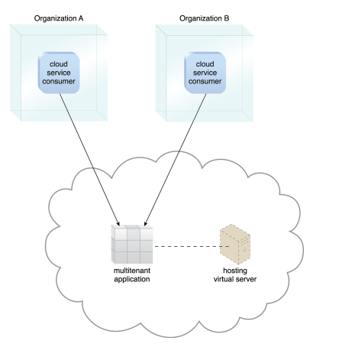
A simple example

Slide 19
Cloud Deployment Models

Slide 20
Cloud Deployment Models
There are four cloud deployment models:
Public
Private
Community
Hybrid
Each deployment model is defined according to where the deployment infrastructure is located

Slide 21
Public Cloud
The name speaks for itself: public clouds are available to the general public, and data are created and stored on third-party servers.
Server infrastructure belongs to service providers that manage it and administer pool resources, which is why there is no need for user companies to buy and maintain their own hardware
Provider companies offer resources as a service both free of charge or on a pay-per-use basis via the Internet
Users can scale resources as required.

Slide 22
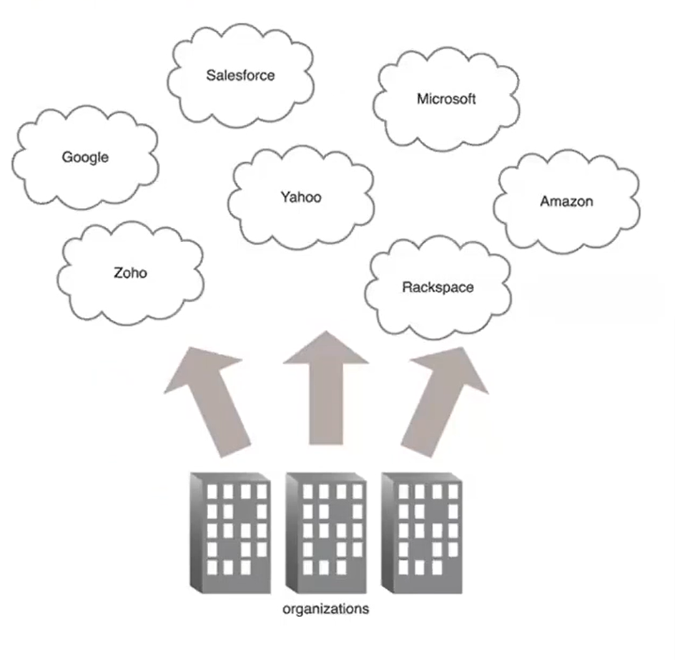
Public Cloud

Slide 23
Benefits of Public Cloud
Minimal Investment - As a pay-per-use service, there is no large upfront cost and is ideal for businesses who need quick access to resources
High scalability. You can easily extend the cloud’s capacity as your company requirements increase
24/7 uptime. The extensive network of your provider’s servers ensures your infrastructure is constantly available and has improved operation time.

Slide 24
Limitations of Public Cloud
Data Security and Privacy Concerns - Since it is accessible to all, it does not fully protect against cyber-attacks and could lead to vulnerabilities.
Reliability Issues - Since the same server network is open to a wide range of users, it can lead to malfunction and outages Example:2016 Salesforce CRM disruption that caused a storage collapse

Slide 25
Private Cloud
There is little to no difference between a public and a private model from the technical point of view, as their architectures are very similar
However, as opposed to a public cloud that is available to the general public, only one specific company owns a private cloud
That is why it is also called an internal or corporate model.

Slide 26
The server can be hosted externally or on the premises of the owner company
Regardless of their physical location, these infrastructures are maintained on a designated private network and use software and hardware that are intended for use only by the owner company
A clearly defined scope of people have access to the information kept in a private repository, which prevents the general public from using it
In light of numerous breaches in recent years, a growing number of large corporations has decided on a closed private cloud model, as this minimizes data security issues
Multiple public cloud service providers, including Amazon, IBM, Cisco, Dell and Red Hat, also provide private solutions.

Slide 27
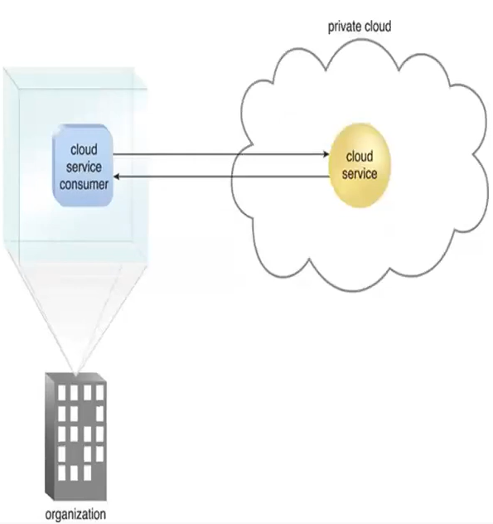
Private Cloud

Slide 28
Benefits of Private Cloud
High security, privacy and reliability, as only authorized persons can access resources
It allows companies to customize their infrastructures in accordance with their requirements

Slide 29
Limitations of Private Cloud
The major disadvantage of the private cloud deployment model is its cost, as it requires considerable expense on hardware, software and staff training
That is why this secure and flexible computing deployment model is not the right choice for small companies.

Slide 30
Community Cloud
A community deployment model largely resembles the private one; the only difference is the set of users
Whereas only one company owns the private cloud server, several organizations with similar backgrounds share the infrastructure and related resources of a community cloud

Slide 31
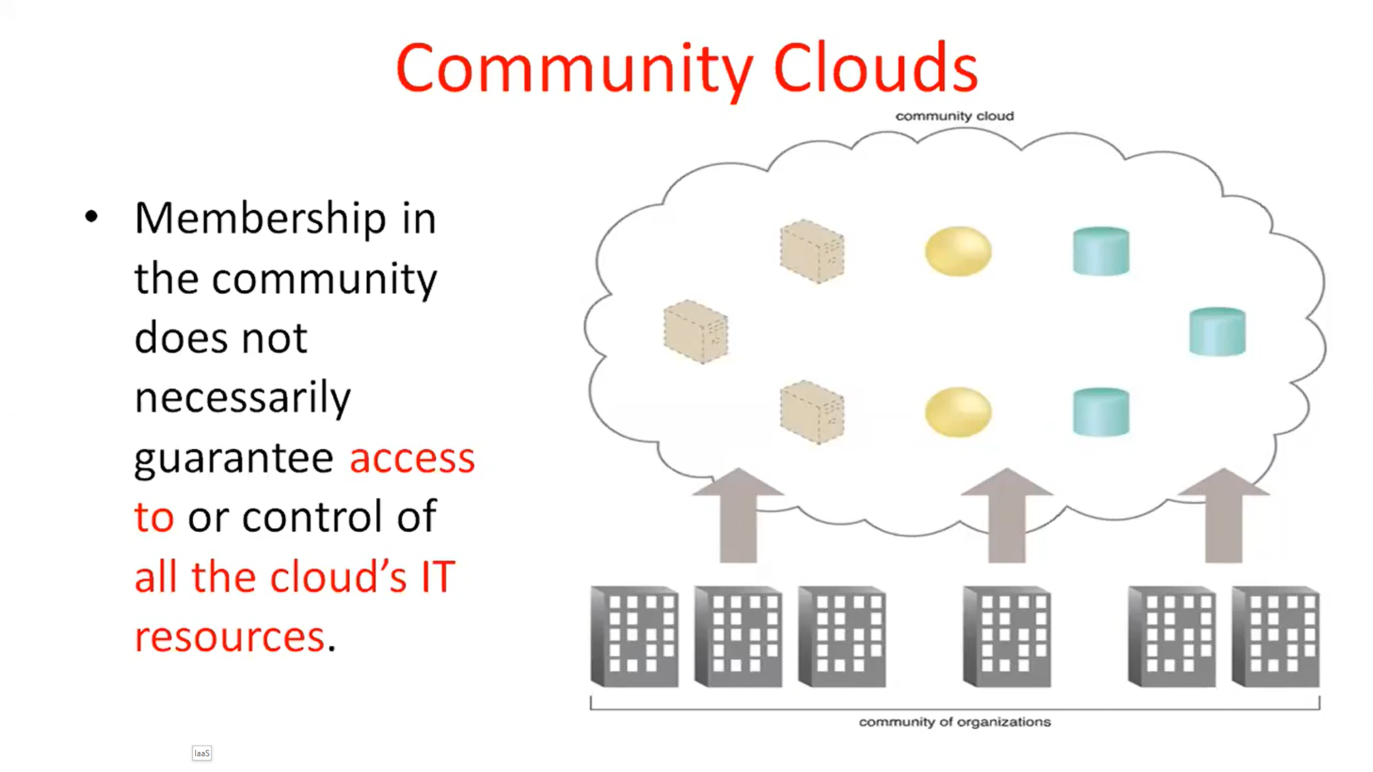
If all the participating organizations have uniform security, privacy and performance requirements, this multi-tenant data center architecture helps these companies enhance their efficiency, as in the case of joint projects
The costs are shared by all users

Slide 32
Benefits of Community Cloud
Smaller Investment - A community cloud is much cheaper than the private cloud and provides great performance
Ease of data sharing and collaboration

Slide 33
Limitations of Community Cloud
High cost compared to the public deployment model
Shared Resources - Due to fixed bandwidth and storage capacity, community resources often pose challenges.
Not as Popular - Since this is a recently introduced model, it is not that popular or available across industries

Slide 34
Hybrid Cloud
As the name suggests, a hybrid cloud is a combination of two or more cloud architectures.
As an example, a company can balance its load by locating mission-critical workloads on a secure private cloud and deploying less sensitive ones to a public one
The hybrid cloud deployment model not only safeguards and controls strategically important assets but does so in a cost- and resource-effective way

Slide 35
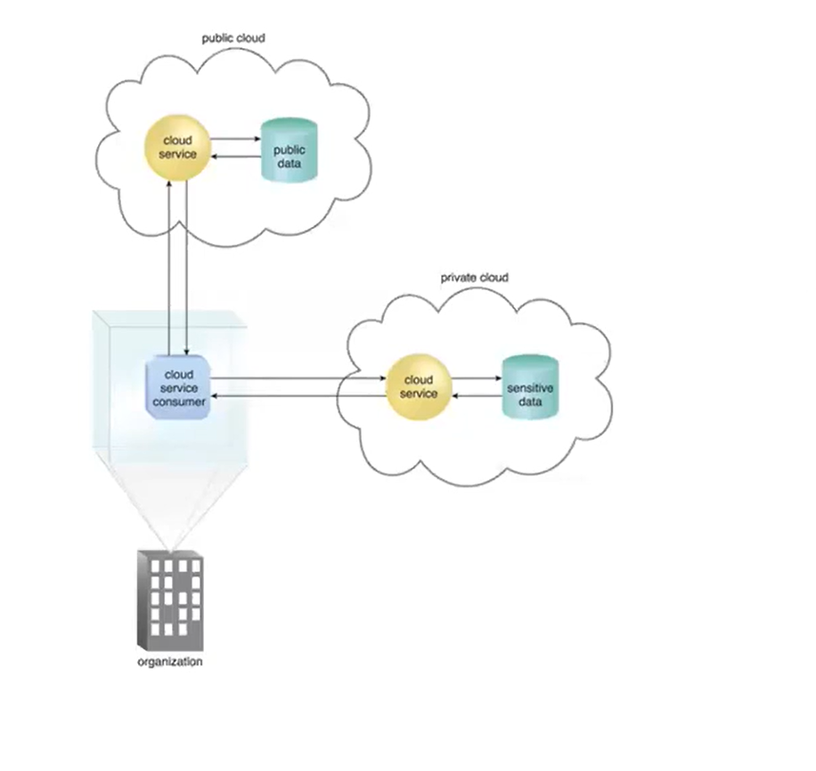
Hybrid Cloud

Slide 36
The Comparison of Top Cloud Deployment Models
 | Public | Private | Community | Hybrid
Ease of setup and use | Easy | Requires IT proficiency | Requires IT proficiency | Requires IT proficiency
Data security and privacy | Low | High | Comparatively high | High
Data control | Little to none | High | Comparatively high | Comparatively high
Reliability | Low | High | Comparatively high | High
Scalability and flexibility | High | High | Fixed capacity | High
Cost-effectiveness | The cheapest | Cost-intensive; the most expensive model | Cost is shared among community members | Cheaper than a private model but more costly than a public one
Demand for in-house hardware | No | Depends | Depends | Depends

Slide 37
What are Iaas, Paas and Saas?
IaaS, PaaS and SaaS are the three most popular cloud service models
IaaS, or infrastructure as a service
PaaS, or platform as a service
SaaS, or software as a service
IaaS, PaaS and SaaS are not mutually exclusive. Many mid-sized businesses use more than one, and most large enterprises use all three.

Slide 38
'As a service' refers to the way IT assets are consumed in these offerings - and to the essential difference between cloud computing and traditional IT
In traditional IT, an organization consumes IT assets - hardware, system software, development tools, applications - by purchasing them, installing them, managing them and maintaining them in its own on-premises data center
In cloud computing, the cloud service provider owns, manages and maintains the assets; the customer consumes them via an Internet connection, and pays for them on a subscription or pay-as-you-go basis.

Slide 39
IaaS
IaaS is on-demand access to cloud-hosted computing infrastructure - servers, storage capacity and networking resources - that customers can provision, configure and use in much the same way as they use on-premises hardware.
The difference is that the cloud service provider hosts, manages and maintains the hardware and computing resources in its own data centers
IaaS customers use the hardware via an internet connection, and pay for that use on a subscription or pay-as-you-go basis.

Slide 40
Customers can provision, configure and operate the servers and infrastructure resources via a graphical dashboard, or programmatically through application programming interfaces (APIs).
In IaaS, user can dynamically choose a CPU, memory storage configuration according to need.
Users can easily access the vast computing power available on IaaS Cloud platform

Slide 41
PaaS
PaaS provides a cloud-based platform for developing, running, managing applications.
The cloud services provider hosts, manages and maintains all the hardware and software included in the platform
We can say PaaS is a programming platform for developers. This platform is generated for the programmers to create, test, run and manage the applications.

Slide 42
Users access the PaaS through a graphical user interface (GUI), where development or DevOps teams can collaborate on all their work across the entire application lifecycle including coding, integration, testing, delivery, deployment, and feedback.
Examples of PaaS solutions include AWS Elastic Beanstalk, Google App Engine, Microsoft Windows Azure, and Red Hat OpenShift on IBM Cloud

Slide 43
SaaS
SaaS is cloud-hosted, ready-to-use application software.
Companies like Google, Microsoft provide their applications as a service to the end users.
Users pay a monthly or annual fee to use a complete application from within a web browser, desktop client or mobile app.
The application and all of the infrastructure required to deliver it - servers, storage, networking, middleware, application software, data storage - are hosted and managed by the SaaS vendor.

Slide 44
Today, anyone who uses a or mobile phone almost certainly uses some form of SaaS.
Email, social media, and cloud file storage solutions (such as Dropbox or Onedrive) are examples of SaaS applications people use every day in their personal lives.

Slide 45
Saas vs. PaaS vs. IaaS: Management Ease vs. Complete Control
SaaS, Paas, IaaS are not mutually exclusive; most organizations use more than one, and many larger organizations today use all three, often in combination with traditional IT
Obviously, the as-a-service solution a customer chooses depends first on the functionality the customer requires, and the expertise it has on staff
For example, an organization without the in-house IT expertise for configuring and operating remote servers isn't well matched to IaaS
An organization without a development team has no need for PaaS.

Slide 46
But in some cases, any of the three 'as-a-service' models will offer a viable solution
In these cases, organizations typically compare the alternatives based on the management ease they offer, vs. the control they give up.
For example, suppose a large organization wants to deliver a customer relationship management (CRM) application to its sales team. It could:
Choose a SaaS CRM solution, offloading all day-to-day management to the third-party vendor, but also giving up all control over features and functionality, data storage, user access and security.

Slide 47
Choose a PaaS solution and build a custom CRM application.
In this case, the company would offload management of infrastructure and application development resources to the cloud service provider.
The customer would retain complete control over application features, but it would also assume responsibility for managing the application and associated data

Slide 48
Build out backend IT infrastructure on the cloud using IaaS, and use it to build its own development platform and application.
The organization's IT team would have complete control over operating systems and server configurations
But it also bear the burden of managing and maintaining them, along with the development platform and applications that run on them.

Slide 49
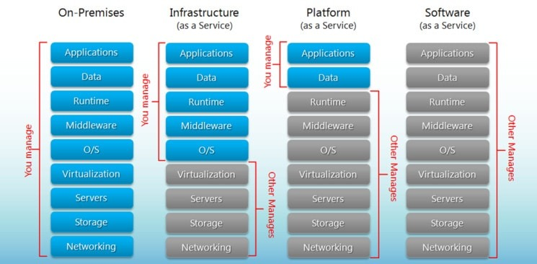
Cloud Computing Services: Who Manages What ?

Slide 50
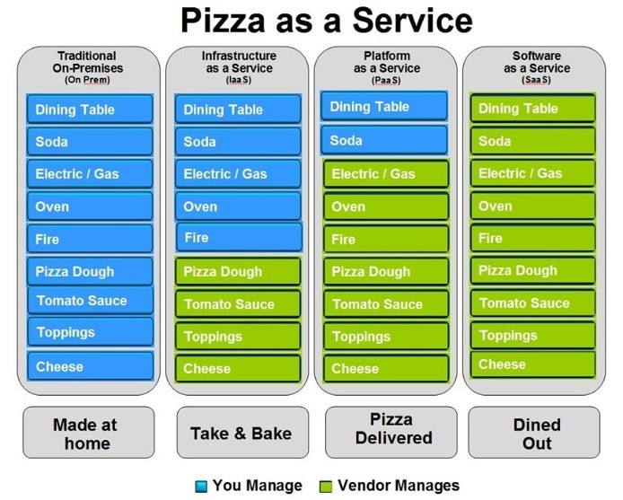
Another visual breakdown

Slide 51
What are the differences between IaaS, PaaS, and SaaS?
IaaS is there to provide you with maximum flexibility when it comes to hosting custom-built apps, as well as a providing a general data center for data storage.
PaaS is most often built on top of an IaaS platform to reduce the need for system administration. It allows you to focus on app development instead of infrastructure management.
SaaS offers ready-to-use, out-of-the-box solutions that meet a particular business need (such as website or email).
You might choose to start with one cloud computing service model or find a need for all three: that depends on the size and complexity of your business.

Slide 52
SaaS accounts for approximately 24% of all enterprise workloads (up from 14% in 2016)
IaaS is hovering around 12%
PaaS is currently the most popular model, hovering around 32% and expected to grow in 2022.

Slide 53
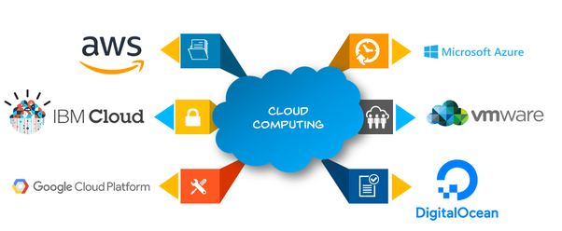
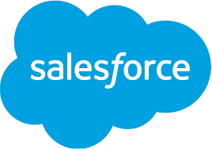
Some Top Vendors of Cloud Computing

Slide 54
Mcqs

Slide 55
Which one of the following can be considered as the most complete cloud computing service model?
PaaS
SaaS
IaaS

Slide 56
Which one of the following can be considered as the most complete cloud computing service model?
PaaS
SaaS
IaaS
Correct Answer: 2 Explanation: The most complete cloud computing service model must contain the computing hardware and software, as well as the solution itself. Hence the SaaS model has all these features.

Slide 57
Which one of the following provides the resources or services such as virtual infrastructure, virtual machines, virtual storage, and several other hardware assets?
PaaS
SaaS
IaaS
All of the above

Slide 58
You plan to provide Infrastructure as a Service (IaaS) resources in Azure. Which resource is an example of IaaS?
an Azure web app
an Azure virtual machine
an Azure logic app
an Azure SQL database

